Slide 1
Zoom Zoom
See more on PowerPoint Zoom: Use zoom for PowerPoint to bring your presentation to life - Office Support (microsoft.com)

Slide 2
Stock Chart summary

Slide 3
Currency Summary

Slide 4
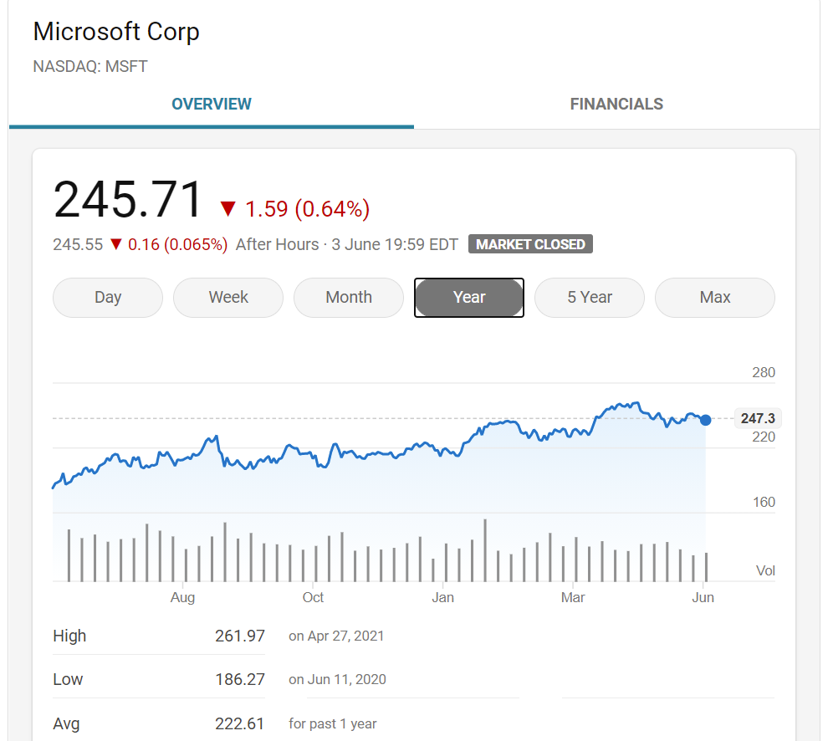

Slide 5
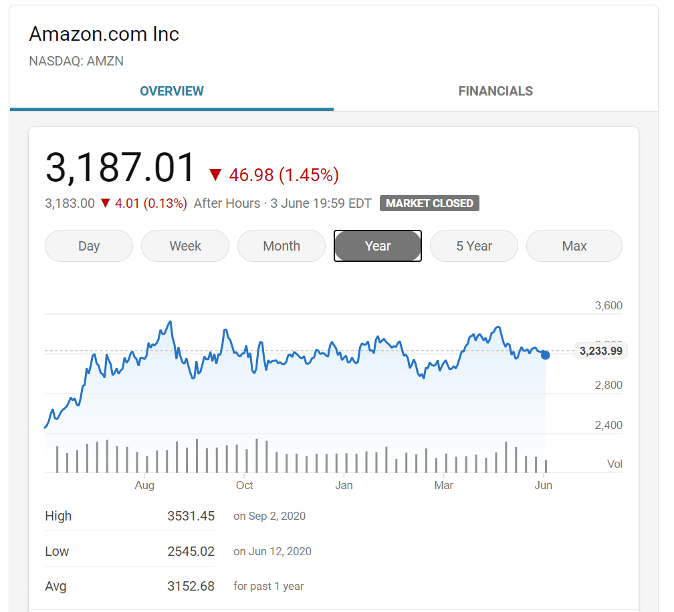

Slide 6
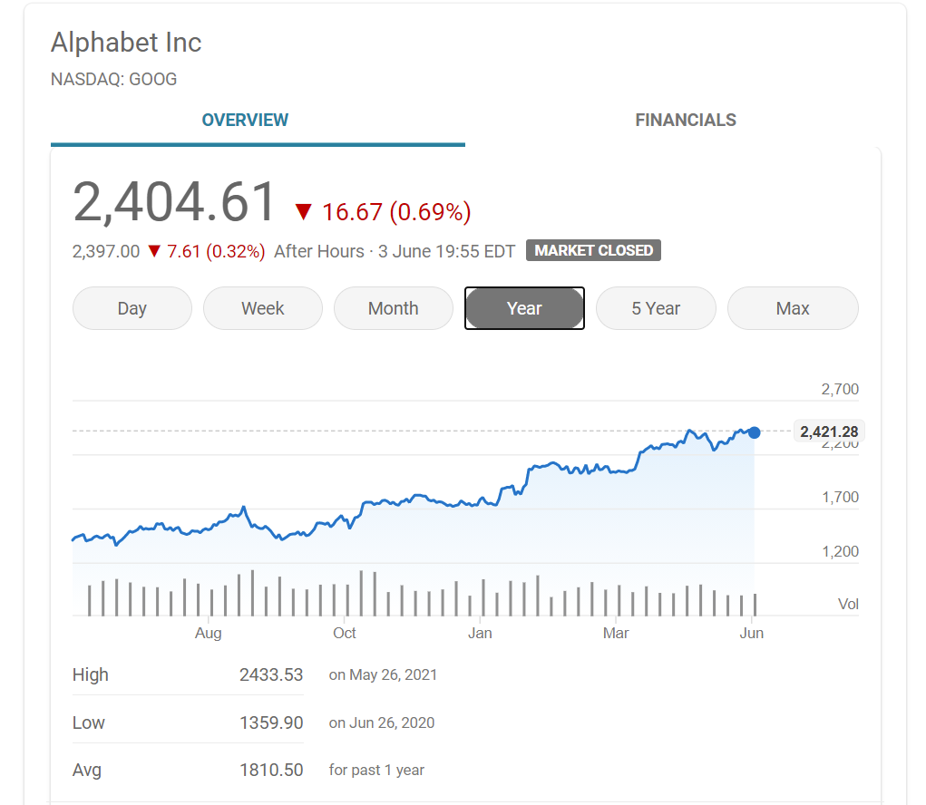

Slide 7
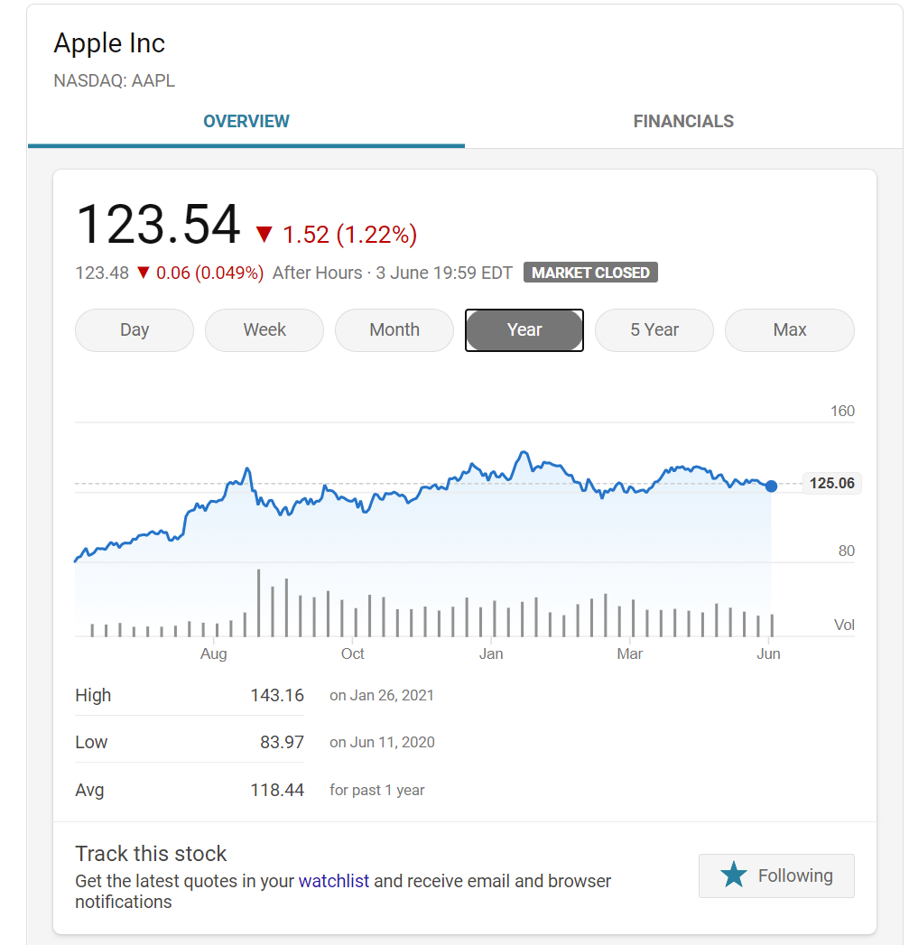

Slide 8
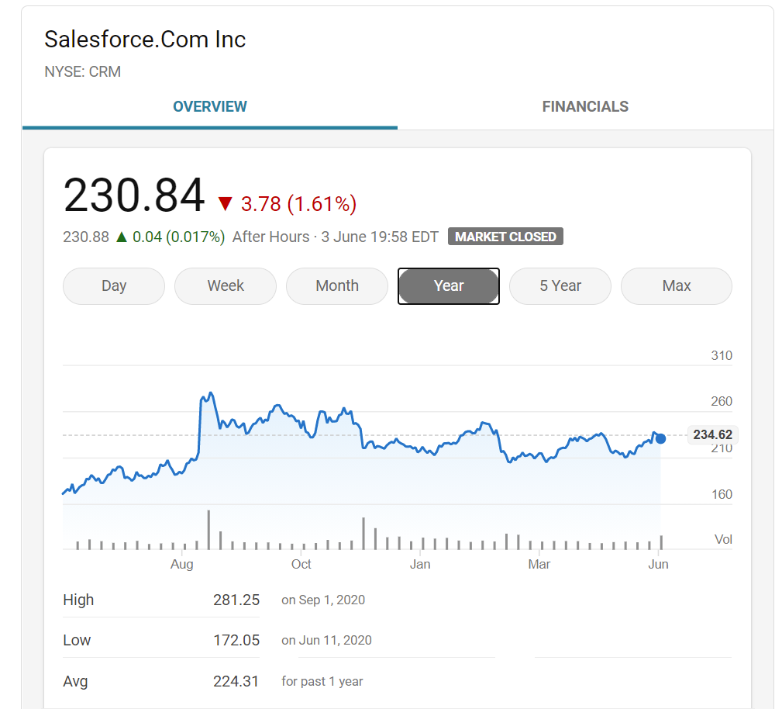

Slide 9
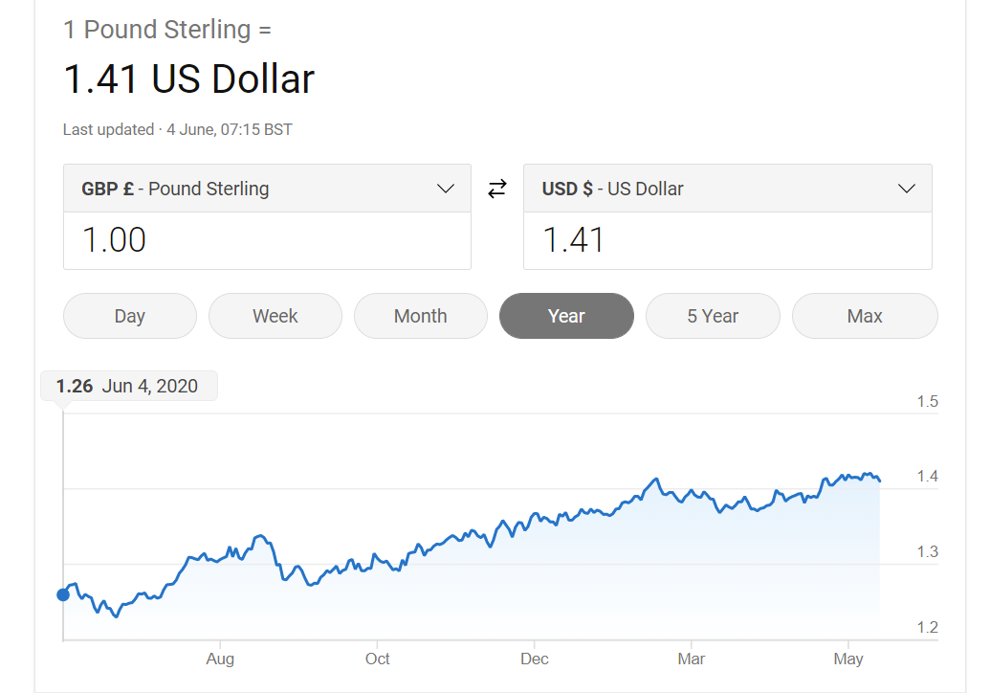

Slide 10
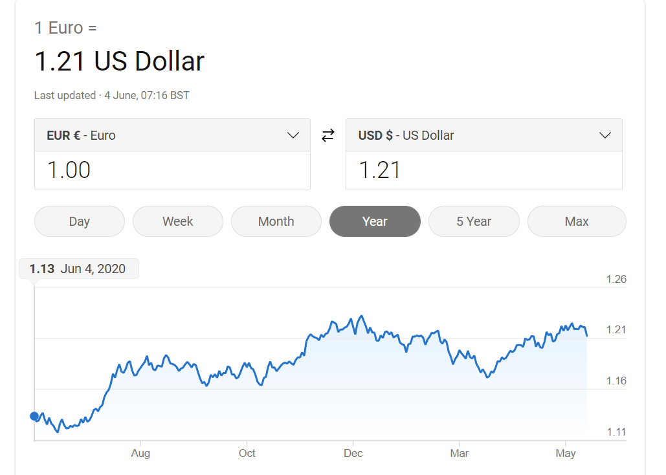

Slide 11
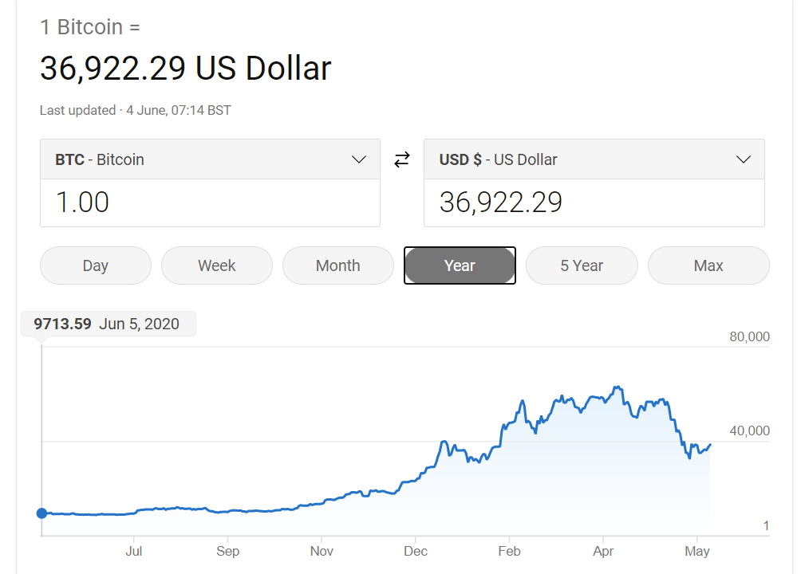

Slide 12
